Slide 1
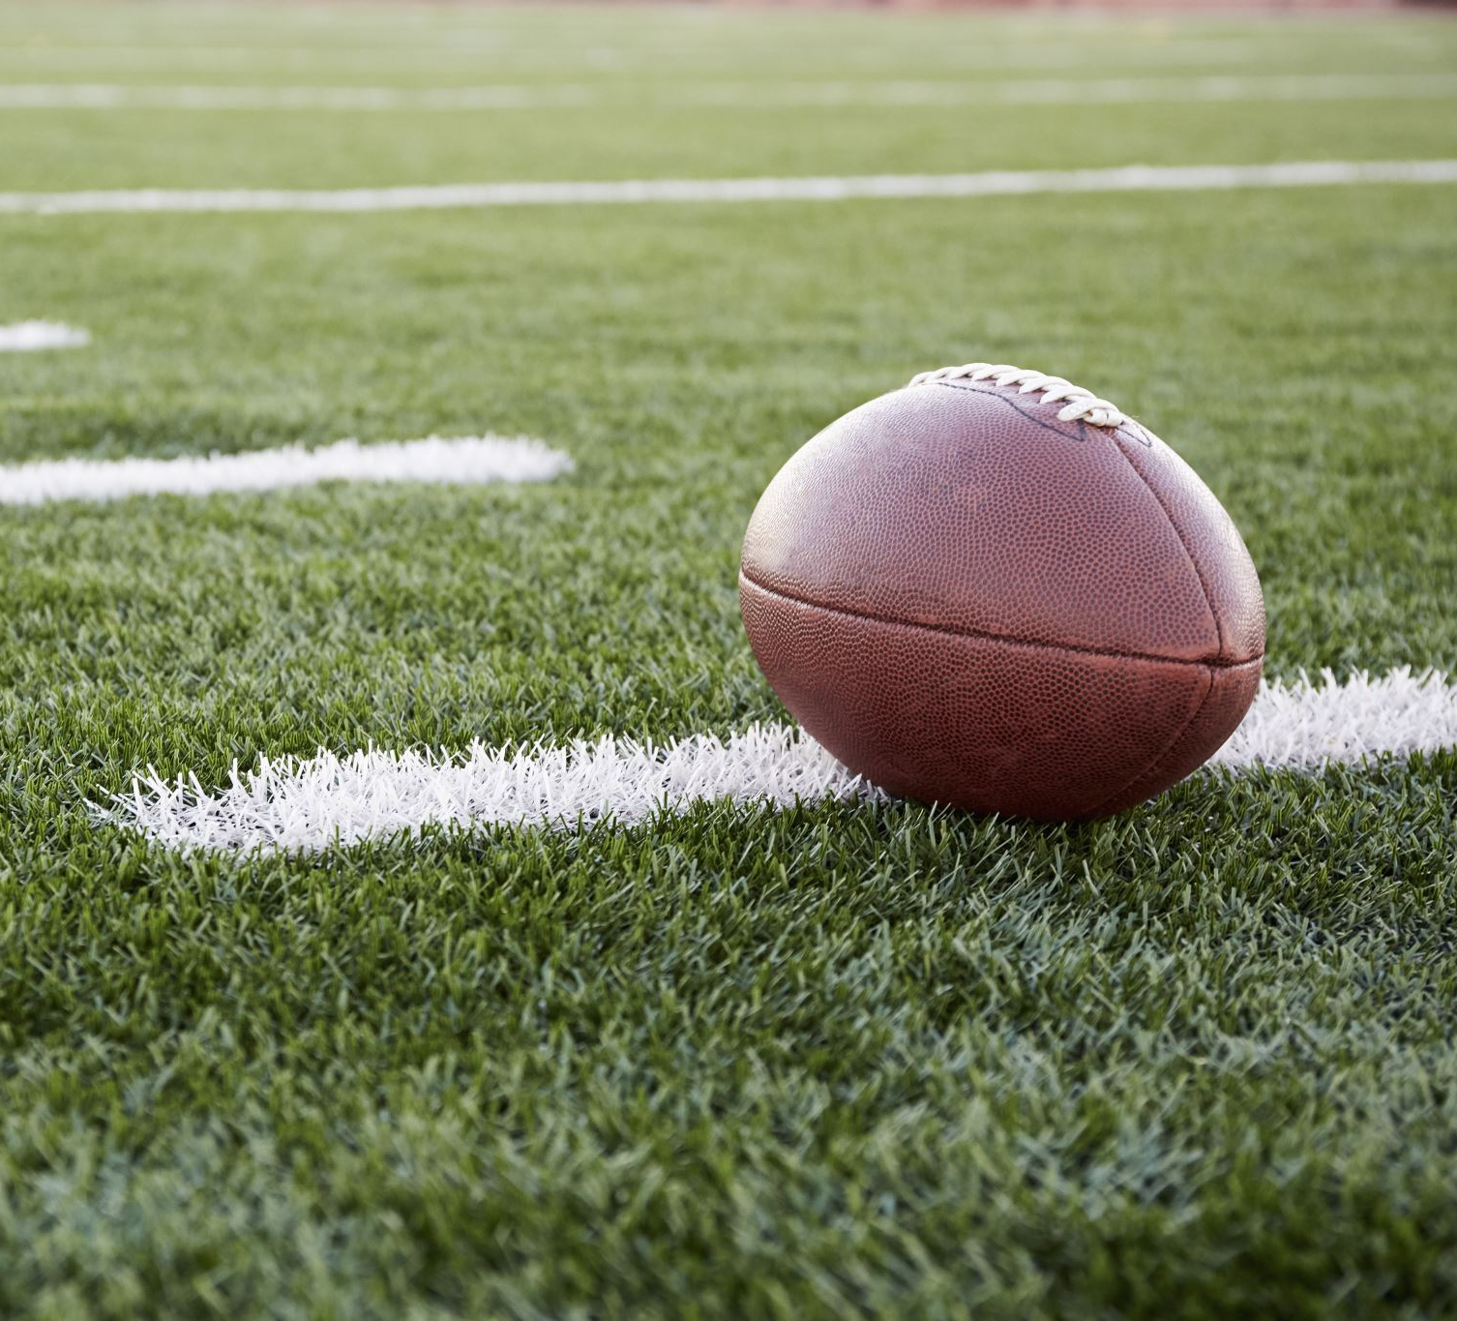
Assessing the Effect of the Score on Interception Rates in the NFL

Slide 2
Introduction
NFL strategy is incredibly context-dependent
Statistics should reflect this
Adjusting for the score was a pivotal development in hockey analytics

Slide 3
Interceptions
Massively impactful events
Hard to predict
Should Be Sensitive to the score
Notes:
That is the hypothesis we will test

Slide 4
The Data
2014 to 2019 (from nflscrapR)

Slide 5
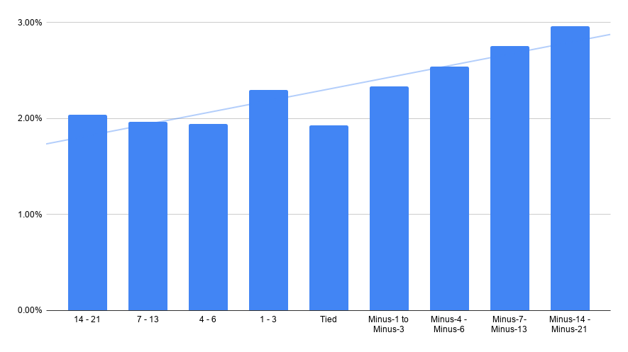
League-wide interception rates
League average = 2.37%

Slide 6
NFL Average Interception Rates
Winning/within three points: 2.0% INT rate
Losing by more than three: 2.8% INT rate
Notes:
For context: Difference between #5 and #14

Slide 7
Analyzing Individual QB Seasons
Between 2014-2019
232 quarterbacks threw at least 50 passes when both winning (or losing by less than four) and losing by more than four

Slide 8
Average decline was ~0.6%
Statistically significant difference

Slide 9
Are Trailing Quarterbacks Attempting Riskier Passes?

Slide 10
Air Yards
The further down the field the pass travels, the more likely it is to be intercepted

Slide 11
Trailing QBs Attempt Deeper Passes
Winning or within three points: 8.0 aDOT
Losing by more than three: 8.5 aDOT
Statistically significant difference
Standard deviation for qualified passers was 1 air yard in 2019

Slide 12
Trailing QBs Also Take More Risks When Controlling for Length
Short passes only
“Trailing Big” QBs have a ~20% higher interception rate

Slide 13
Applications
Adds context to in-season leaderboards
Provides more accurate rankings

Slide 14
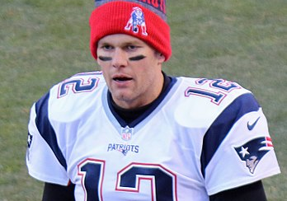
What Do They Have In Common?

Slide 15
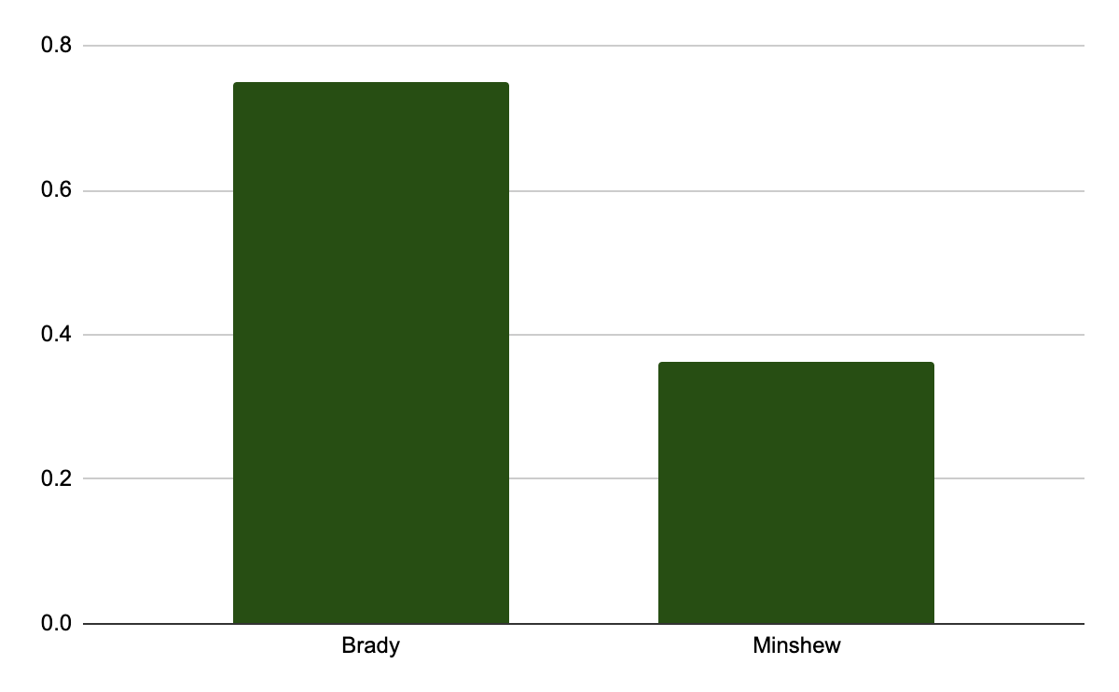
% of Throws Winning/Within 3 Points

Slide 16
Biggest Overachievers
Passer | INT Rate | xINT Rate | Diff
G.Minshew | -0.91 | 1.49 | 2.40
C.Wentz | -1.19 | 0.45 | 1.64
C.Keenum | -0.18 | 1.26 | 1.44
M.Mariota | -0.92 | 0.41 | 1.33
D.Prescott | -0.69 | 0.55 | 1.23
R.Wilson | -1.21 | 0.02 | 1.23
A.Dalton | 0.44 | 1.56 | 1.12
D.Jones | 0.38 | 1.49 | 1.11
A.Rodgers | -1.47 | -0.59 | 0.87
(Z-Scores)

